Slide 1
618270-EPP-1-2020-1-LT-EPPKA2-CBHE-JP
Digitalization of economic as an element of sustainable development of Ukraine and Tajikistan / DigEco
Preventing Monitoring Meeting:
1st DigEco Year results at Zhytomyr Polytechnic State University
October 22, 2021
This project has been funded with support from the European Commission. This presentation reflects the views only of the author, and the Commission cannot be held responsible for any use which may be made of the information contained there in.

Slide 2
WORK PLAN: WP1
1 DigEco Year
Development and approval of DigEco Strategy | 15.11.2020-14.12.2020
Conduct kick-of meeting at P1 in 3M1Y | 15.12.2020-14.01.2021
1. P1-P3: SWOT analyze on current status of DE curricular in EU. 2.P4-P8: SWOT analyze on current status of DE curricular in UA 3. SWOT analyze on current status of DE curricular in TJK 4. P12-P16: reports of lack of educational skills in target area/ needs of skills in the area of strategic management and operating efficiency 5. P8, P10, P12: reports of inclusive educational level in PC, report of low level of competitiveness of people with disabilities on labour market 6. P3-P4: the conception of VPLP inc. PIE implementation. 7. P13: guideline on basic steps of curricular digitalization (A work plan of curriculum development and their updating incl. Timetable). 8. P4 International Work Groups on curricular development created. 9. P1-P3: academic teachers training courses guidelines. 10. web platform.
https://drive.google.com/drive/u/1/folders/16wAbIVhHgqUFm5d5Tai60I7gKyyfd2qQ
https://learn.ztu.edu.ua/enrol/index.php?id=4179
This project has been funded with support from the European Commission. This presentation reflects the views only of the author, and the Commission cannot be held responsible for any use which may be made of the information contained there in.

Slide 3
WORK PLAN: WP2
1 DigEco Year
Joint development of 13 DigEco сcurricular | 15.02.2021- 14.06.2021 | 13 new core curricula developed https://learn.ztu.edu.ua/enrol/index.php?id=4179
Develop guidelines and retrain PCs academic teachers in EU HEIs on new 13 DigEco сcurricular methodology | 15.03.2021- 14.05.2021 | ZPSU take part in this teachings https://drive.google.com/drive/u/1/folders/1phdlGYWK9d9nMoU41PEsmR3UGmFV2YWQ
Adopt guidelines and retrain PCs academic teachers at PCs home basis on new curricula methodology | 15.04.2021-14.06.2021 | 12 teachers from target PCs (P6) are trained https://drive.google.com/drive/u/1/folders/1phdlGYWK9d9nMoU41PEsmR3UGmFV2YWQ
Component and development/upload VPLP | 15.04.2021-14.08.2021 | Developed teaching materials at P1-P16 https://learn.ztu.edu.ua/enrol/index.php?id=4179
This project has been funded with support from the European Commission. This presentation reflects the views only of the author, and the Commission cannot be held responsible for any use which may be made of the information contained there in.

Slide 4
WORK PLAN: WP2
1 DigEco Year
Accreditation in accordance with national legislation (UA and TJK) | 15.03.2021-14.05.2021 | P4-P11 according national law https://drive.google.com/drive/u/1/folders/16wAbIVhHgqUFm5d5Tai60I7gKyyfd2qQ
Update joint for P6 | 15.11.2020- during the DigEco | DigEco project website P1-16 created project page at official site https://dig2eco.ztu.edu.ua/
Establishment of VIDEL Labs | 15.02.2021-14.10.2021 | VIDEL Labs incl.PIE with window grills and combination locks VPLP (spaces) regulation on the functioning of these units at target HEIs, equipment delivered to balance (in progress)
Pilot teaching of MA students using DigEco educational environment | 01.09.2021-14.10.2021 | https://learn.ztu.edu.ua/enrol/index.php?id=4179
This project has been funded with support from the European Commission. This presentation reflects the views only of the author, and the Commission cannot be held responsible for any use which may be made of the information contained there in.

Slide 5
WORK PLAN: WP3
1 DigEco Year
Quality control mechanism /developing and approval of QA Plan | 15.01.2021-14.02.2021 | Quality Assurance Group set (QAG), which will include representatives from P1-P16 , final report Intermediate reports/surveys provided. Self-evaluation plan will developed at each Ps. https://drive.google.com/drive/u/1/folders/16wAbIVhHgqUFm5d5Tai60I7gKyyfd2qQ
Monitoring of DigEco KPI | 15.11.2020 - during the DigEco | Approved dissemination, quality plan, revised work plan Participants lists, surveys, questionnaires, project reports, feedbacks from stakeholders (business, government organizations etc) https://drive.google.com/drive/u/1/folders/16wAbIVhHgqUFm5d5Tai60I7gKyyfd2qQ
This project has been funded with support from the European Commission. This presentation reflects the views only of the author, and the Commission cannot be held responsible for any use which may be made of the information contained there in.

Slide 6
WORK PLAN: WP3
1 DigEco Year
Performing satisfaction surveys among the target groups | 5.03.2021-14.04.20211 15.06.2021-14.07.2020 15.09.2021-14.10.2021 | Evaluated criteria and survey questioners for teachers/students/stakeholders developed PCs teacher survey, 2rd project year surveys conducted on pilot students teaching, quality indicators developed (in progress) https://docs.google.com/forms/d/1q8WyKQDyWOw8-TEJ1JjWCTOjPJps9eo-e_BTnKLblTA/viewform?fbclid=IwAR1BUxWnBDLkwTFFCls7HVfjxpQcRfCRu0hOEodpqxLF3yIWmokIWFEen0w&edit_requested=true https://docs.google.com/forms/d/1q8WyKQDyWOw8-TEJ1JjWCTOjPJps9eo-e_BTnKLblTA/viewform?edit_requested=true
Internal quality assessment | 15.12.2020 15.02.2021 15.04.2021 15.06.2021 15.08.2021 15.10.2021 15.09.2021 | Approved dissemination, quality plan, revised work plan for P6 Participants lists, surveys, questionnaires, project reports, feedbacks from stakeholders (business, government оrganizations etc) https://drive.google.com/drive/u/1/folders/16wAbIVhHgqUFm5d5Tai60I7gKyyfd2qQ
This project has been funded with support from the European Commission. This presentation reflects the views only of the author, and the Commission cannot be held responsible for any use which may be made of the information contained there in.

Slide 7
WORK PLAN: WP4
1 DigEco Year
External Evaluation | 15.01.2021-14.02.2021 15.09.2021-14.10.2021 | According to schedule
Dissemination ,Exploitation and Sustainability Strategy and Plan development | 15.11.2020 14.01.2021 | Special Dissemination Exploitation and Sustainability Plan https://drive.google.com/drive/u/1/folders/16wAbIVhHgqUFm5d5Tai60I7gKyyfd2qQ
Full media coverage of the project activities incl. joint WEB based platform, groups in social networks; | 15.11.2020- during the DigEco | Project site, Facebook and social groups and networks https://dig2eco.ztu.edu.ua/ https://t.me/ztueduua https://www.facebook.com/groups/1136322603112748 https://news.ztu.edu.ua
Management of the project at P6 | 15.11.2020 - during the DigEco | https://drive.google.com/drive/u/1/folders/16wAbIVhHgqUFm5d5Tai60I7gKyyfd2qQ
This project has been funded with support from the European Commission. This presentation reflects the views only of the author, and the Commission cannot be held responsible for any use which may be made of the information contained there in.

Slide 8
WORK PLAN: WP5
1 DigEco Year
International Project meetings | 15.12.2020-14.01.2021 (at kick off ) | Partnership agreements, Procurement plan, Memorandum/Partnership Agreements, Strategy - P1 and other Ps: Dissemination strategy, Quality Plan https://dig2eco.ztu.edu.ua/2020/12/%d0%bf%d0%b5%d1%80%d1%88%d0%b0-%d0%ba%d0%be%d0%be%d1%80%d0%b4%d0%b8%d0%bd%d0%b0%d1%86%d1%96%d0%b9%d0%bd%d0%b0-%d0%b7%d1%83%d1%81%d1%82%d1%80%d1%96%d1%87-%d0%bf%d0%b0%d1%80%d1%82%d0%bd%d0%b5%d1%80/
Regional Project meetings | 15.04.2021-14.05.2021 | 6M1Y at P7 Apr at Kamianets-Podіlskyi, Mariupol, Zhytomyr , Melitopol, zoom https://dig2eco.ztu.edu.ua/2021/09/%d0%bc%d1%96%d0%b6%d0%bd%d0%b0%d1%80%d0%be%d0%b4%d0%bd%d0%b0-%d0%bd%d0%b0%d1%83%d0%ba%d0%be%d0%b2%d0%be-%d0%bf%d1%80%d0%b0%d0%ba%d1%82%d0%b8%d1%87%d0%bd%d0%b0-%d0%ba%d0%be%d0%bd%d1%84%d0%b5%d1%80/ https://dig2eco.ztu.edu.ua/2021/05/%d0%bc%d1%96%d0%b6%d0%bd%d0%b0%d1%80%d0%be%d0%b4%d0%bd%d0%b0-%d0%ba%d0%be%d0%bd%d1%84%d0%b5%d1%80%d0%b5%d0%bd%d1%86%d1%96%d1%8f-digeco-digitalization-of-the-economy-as-a-factor-sustainable-developme/ https://dig2eco.ztu.edu.ua/2021/05/%d0%ben-line-%d0%ba%d0%be%d0%bd%d1%84%d0%b5%d1%80%d0%b5%d0%bd%d1%86%d1%96%d1%8f/
Virtual international/regional project meetings | Every second month | Platform Zoom
This project has been funded with support from the European Commission. This presentation reflects the views only of the author, and the Commission cannot be held responsible for any use which may be made of the information contained there in.

Slide 9
WORK PLAN
Activities: Teaching/training, Syllabi Development, Strategy Documents Development, Quality and Overall Management
Deadlines: 15.11.2020 – 14.05.2021
Implementation: Done
I
Activities: Purchasing equipment / Establishment of VIDEL Labs incl. PIE
Deadlines: 15.02.2021 – 14.05.2022
Implementation: Running
II
Activities: Pilot Teaching of MA students using DigEco
Educational Environment
Deadlines: 01.09.2021 – 30.06.2022
Implementation: Start
III
This project has been funded with support from the European Commission. This presentation reflects the views only of the author, and the Commission cannot be held responsible for any use which may be made of the information contained there in.

Slide 10
WORK PLAN: WP2
Joint development of 13 DigEco disciplines to modernize current /
implement new curricular incl. PIE
On-line trainings at EU universities
(February 25 – March 23, 2021)
10 teachers / representatives took part at the trainings
► Teachers of the Faculty of Business and Service Sector.
► Teachers of Faculty of Information and Computer Technologies.
► Dean of the Faculty of Business and Service Sector.
► The First Vice-Rector.
► Vice-Rector for Scientific and Pedagogical Work.
► Moderator and Technical Support of the DigEco Project.
This project has been funded with support from the European Commission. This presentation reflects the views only of the author, and the Commission cannot be held responsible for any use which may be made of the information contained there in.

Slide 11
WORK PLAN: WP2
DigEco disciplines developed and adopted
► Fintech in banking, insurance and asset management.
► Blockchain, innovation management and disruptive technology.
► Digital marketing in action.
► Design thinking.
► Digital performance in business and economics.
► Big data analytics and business intelligence.
► Data analytics for marketing.
► Digital business models.
► Digital literacy.
► Big data analytics in finance.
► Big data management.
► Agile project management.
► Data entrepreneurship in action.
https://news.ztu.edu.ua/2021/06/didzhytal-dystsypliny-u-programah-pidgotovky-ekonomistiv-ta-mizhnarodnykiv-zhytomyrskoyi-politehniky/
This project has been funded with support from the European Commission. This presentation reflects the views only of the author, and the Commission cannot be held responsible for any use which may be made of the information contained there in.

Slide 12
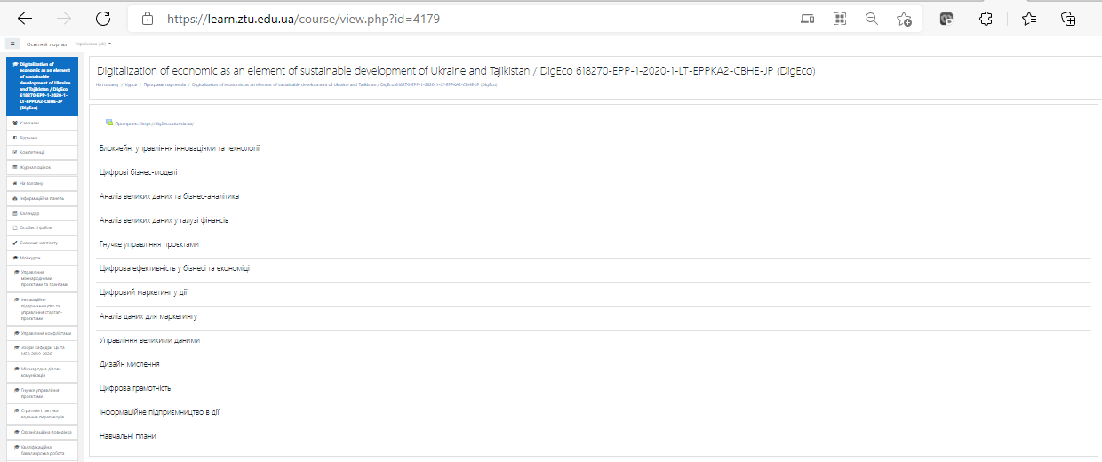
WORK PLAN: WP2
DigEco disciplines implemented at the Educational Plans
at 2 Faculties, 4 educational programs for 82 master-students
Moodle: Digitalization of economic as an element of sustainable development of Ukraine and Tajikistan / DigEco 618270-EPP-1-2020-1-LT-EPPKA2-CBHE-JP (DigEco) (ztu.edu.ua)
This project has been funded with support from the European Commission. This presentation reflects the views only of the author, and the Commission cannot be held responsible for any use which may be made of the information contained there in.

Slide 13
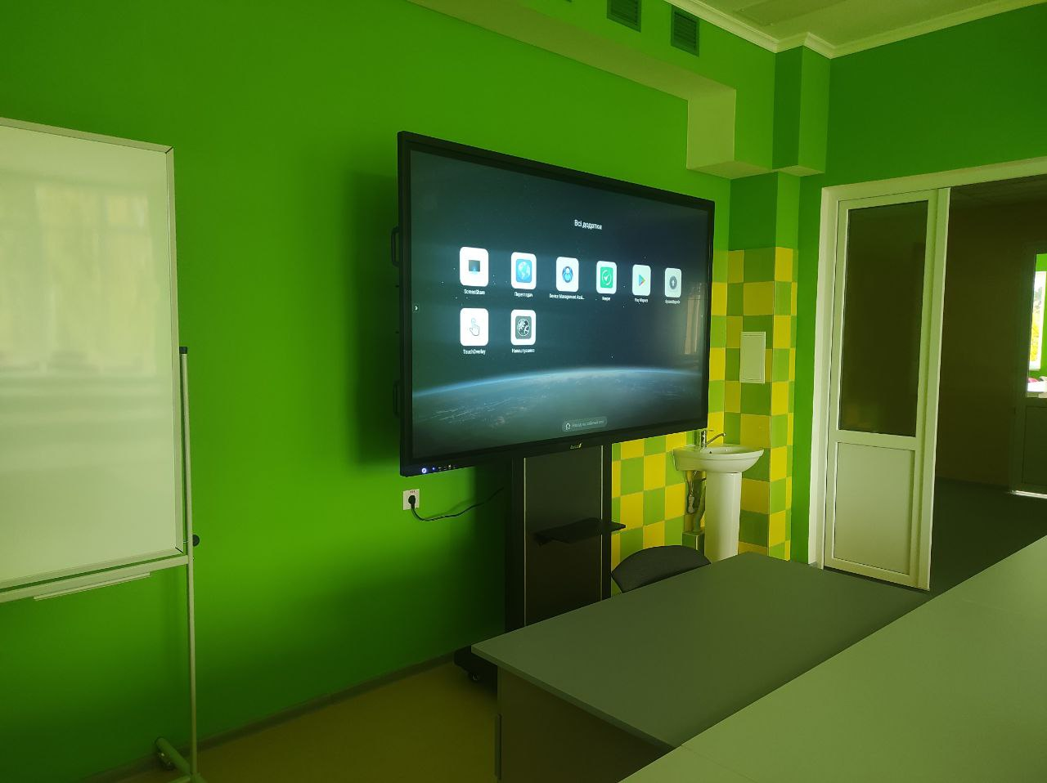
WORK PLAN: WP2
Eqiupment for DigEco disciplines implementation
23 266.37 EUR
67% of equipment budget
This project has been funded with support from the European Commission. This presentation reflects the views only of the author, and the Commission cannot be held responsible for any use which may be made of the information contained there in.

Slide 14
WORK PLAN: WP3
Evaluation of trainings of UA and TJK teachers on DigEco curricular’ development
1
Indicative Questions to determine the
level of awareness about DigEco
project among target groups (students,
PhD students, teacher, stakeholders).
Total 10+ respondents.
2
Online workshops for target universities
(February – March 2021). Survey on online
training satisfaction.
Total 10+ respondents.
3
Evaluation of syllabuses by stakeholders.
Total 10 respondents.
This project has been funded with support from the European Commission. This presentation reflects the views only of the author, and the Commission cannot be held responsible for any use which may be made of the information contained there in.

Slide 15
WORK PLAN: WP3
Evaluation of trainings of UA and TJK teachers on DigEco curricular’ development
Development a questionnaire for University students / graduates / undergraduates
concerning the level of awareness about DigEco project, sharing and conducting the survey questioners, P6:
► to determine the level of awareness about the DigEco project among target groups (students, PhD students, teachers, stakeholders): the questioner «Indicative Questions to determine the level of awareness about the DigEco project among target groups»
March 01, 2021
(DigEco анкета final.docx – Google Документы), https://docs.google.com/document/d/1cQizTzz2nnHNksl9zcxF4gkuj-CIdJtj/edit;
► for «DigEco Online Training Satisfaction Results» feedbacks
March 01–15, 2021
(To check link: https://docs.google.com/forms/d/1q8WyKQDyWOw8-TEJ1JjWCTOjPJps9eo-e_BTnKLblTA/viewform?fbclid=IwAR1BUxWnBDLkwTFFCls7HVfjxpQcRfCRu0hOEodpqxLF3yIWmokIWFEen0w&edit_requested=true
This project has been funded with support from the European Commission. This presentation reflects the views only of the author, and the Commission cannot be held responsible for any use which may be made of the information contained there in.

Slide 16
WORK PLAN: WP4
Activities | Deadlines | Implementers
Dissemination, Exploitation and Sustainability Strategy and Plan development | 15.12.2020 – 14.01.2021 | All Ps
Full media coverage of the project activities incl. joint WEB based platform, groups in social networks | During DigEco running | All Ps
DigEco project WEB platform in function | 15.12.2020 – during DigEco running | All Ps
This project has been funded with support from the European Commission. This presentation reflects the views only of the author, and the Commission cannot be held responsible for any use which may be made of the information contained there in.

Slide 17
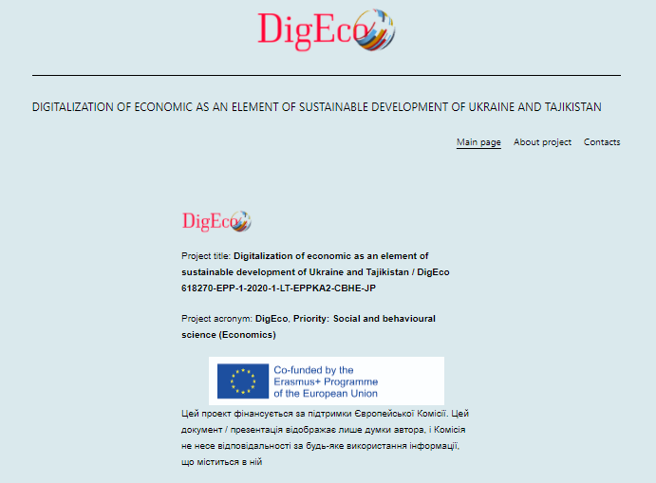
WORK PLAN: WP4
DigEco page at official site
https://dig2eco.ztu.edu.ua/
This project has been funded with support from the European Commission. This presentation reflects the views only of the author, and the Commission cannot be held responsible for any use which may be made of the information contained there in.

Slide 18
WORK PLAN: WP5
ZPSU Dissemination Events
Zhytomyr Polytechnic is the winner of the Erasmus + / Higher Education Capacity Development competition, Kick-off for P6 and local meetings August 01, 2020
This project has been funded with support from the European Commission. This presentation reflects the views only of the author, and the Commission cannot be held responsible for any use which may be made of the information contained there in.

Slide 19
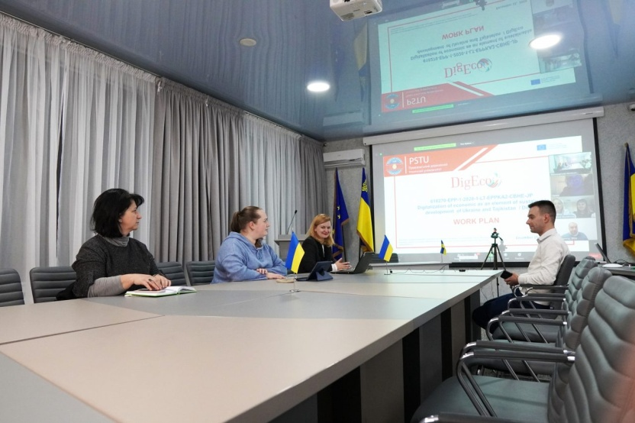
WORK PLAN: WP5
ZPSU Dissemination Events
The first coordination meeting of the project partners of the EU Higher Education Capacity Development Program
December 15, 2020
DigEco Kick-off Meeting
December 12, 2021
This project has been funded with support from the European Commission. This presentation reflects the views only of the author, and the Commission cannot be held responsible for any use which may be made of the information contained there in.

Slide 20
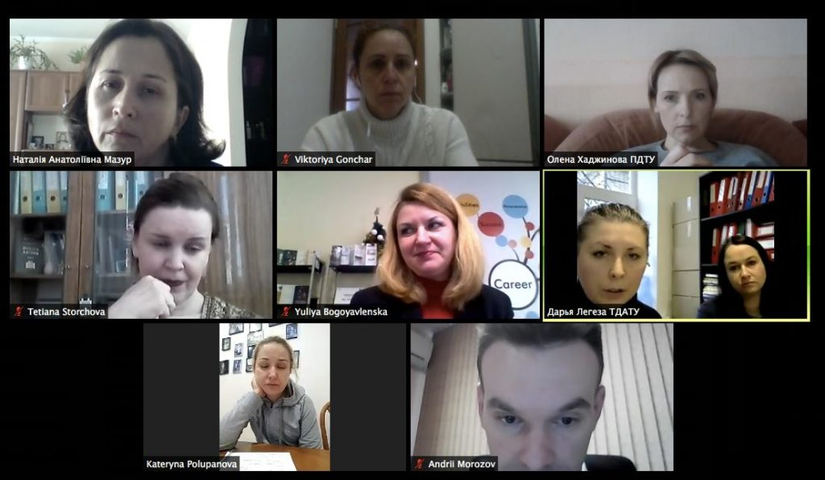
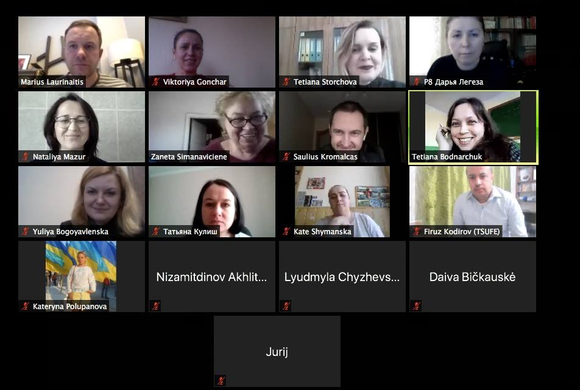
WORK PLAN: WP5
ZPSU Dissemination Events
DigEco conference (online meeting) Ukrainian and Tajik Regional needs in the
Digital Economy February 16, 2021
Zoom DigEco with Ukrainian coordinators and Quality Team to discuss strategy for curriculum development in Ukrainian and European regulation
February 23, 2021
This project has been funded with support from the European Commission. This presentation reflects the views only of the author, and the Commission cannot be held responsible for any use which may be made of the information contained there in.

Slide 21
WORK PLAN: WP2
ZPSU Training Events
Organization and partiipation in master classes of EU teachers at P6, Curriculum Development Team Participation at the EU DigEco trainings (master-classes of EU teachers), according to internal order (according to criteria for the selection of teachers to participate in trainings at EU universities); studying new curricula descriptions and training materials from EU universities
February 25 – March 23, 2021
This project has been funded with support from the European Commission. This presentation reflects the views only of the author, and the Commission cannot be held responsible for any use which may be made of the information contained there in.

Slide 22
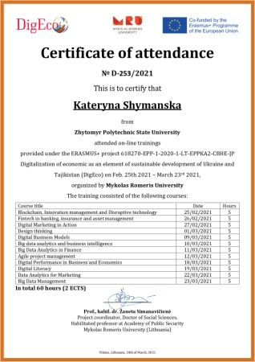
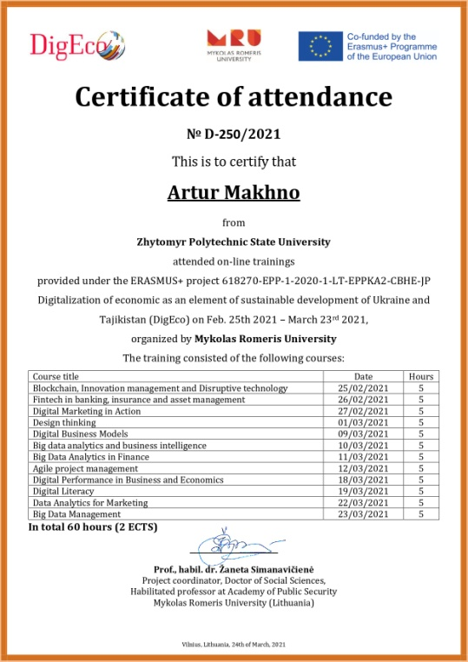
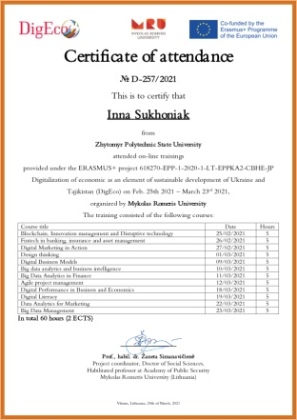
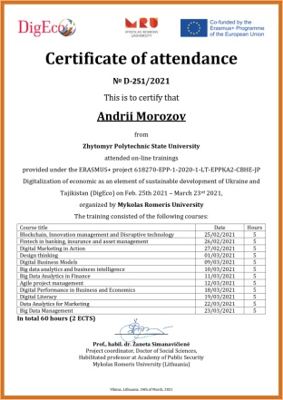
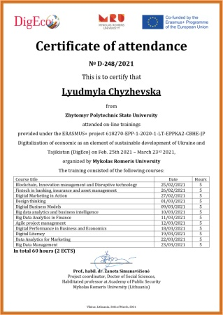
WORK PLAN: WP2
ZPSU Training Events
Certificate of attendance of successful completion of studies of DigEco February 25 – March 23, 2021
This project has been funded with support from the European Commission. This presentation reflects the views only of the author, and the Commission cannot be held responsible for any use which may be made of the information contained there in.

Slide 23
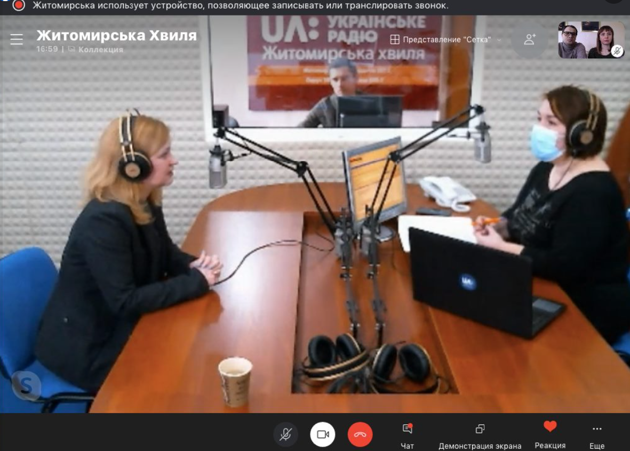
WORK PLAN: WP4
ZPSU Dissemination Events
DigEco Dissemination through TV&radio channels – UA:Suspil’ne, «Zhytomyrska Hvylia» interview – online broadcast with Coordinator of P6 about the Erasmus+ DigEco project
January 23, 2021
DigEco Dissemination though UA:Suspilne,
«Zhytomyrska Hvylia» interview, media-bridge
Zhytomyr - Mariupol’
February 16, 2021
This project has been funded with support from the European Commission. This presentation reflects the views only of the author, and the Commission cannot be held responsible for any use which may be made of the information contained there in.

Slide 24
WORK PLAN: WP1
ZPSU Dissemination Events
Presenting milestones of DigEco Erasmus+ project quality on 2 round tables with stakeholders for changes into Educational Plans and Professional Programs:
► 051 Economics (Master),
April 28, 2021;
► 292 International Economic Relations (Master)
May 19, 2021
This project has been funded with support from the European Commission. This presentation reflects the views only of the author, and the Commission cannot be held responsible for any use which may be made of the information contained there in.

Slide 25
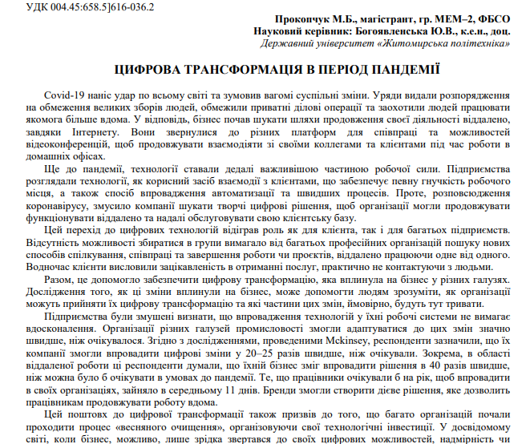
WORK PLAN: WP4
ZPSU Scientific Dissemination Events
Presenting milestones of DigEco Erasmus+ project quality on the Youth Scientific Council
May 5, 2021
Preparing, sharing and promoting Conference in Zhytomyr Polytechnic
State University, dated to May 11–13, 2021, Section «Digital Economy as an
Element of Sustainable Development»
https://conf.ztu.edu.ua/wp-content/uploads/2021/05/12.-vplyv-inovats.-zmin-na-roz-k-susp.-s.-5.pdf
This project has been funded with support from the European Commission. This presentation reflects the views only of the author, and the Commission cannot be held responsible for any use which may be made of the information contained there in.

Slide 26
WORK PLAN: WP4
ZPSU Scientific Dissemination Events
Participating in the International Scientific-Practical Conference “Digitalisation of the Economy as a Factor of Sustainable Development”,
SHEI “Pryazovskyi State Technical University”, Mariupol, Ukraine, May 25–26, 2021
International Scientific-Practical Conference «Digital business transformation: challenges and opportunities for partnership», Tavria State Agrotechnological University named after Dmitro Motorny,
September 9–10, 2021
This project has been funded with support from the European Commission. This presentation reflects the views only of the author, and the Commission cannot be held responsible for any use which may be made of the information contained there in.

Slide 27
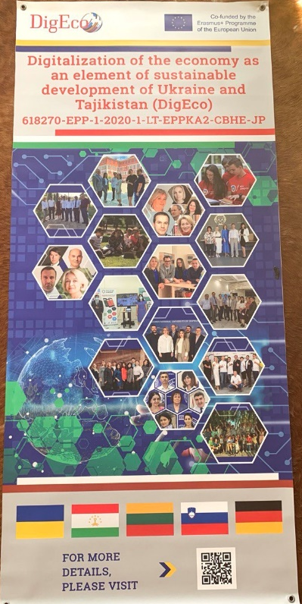
WORK PLAN: WP4
ZPSU Dissemination Events
Part of project banner prepared and placed at ZPSU – DigEco
This project has been funded with support from the European Commission. This presentation reflects the views only of the author, and the Commission cannot be held responsible for any use which may be made of the information contained there in.

Slide 28
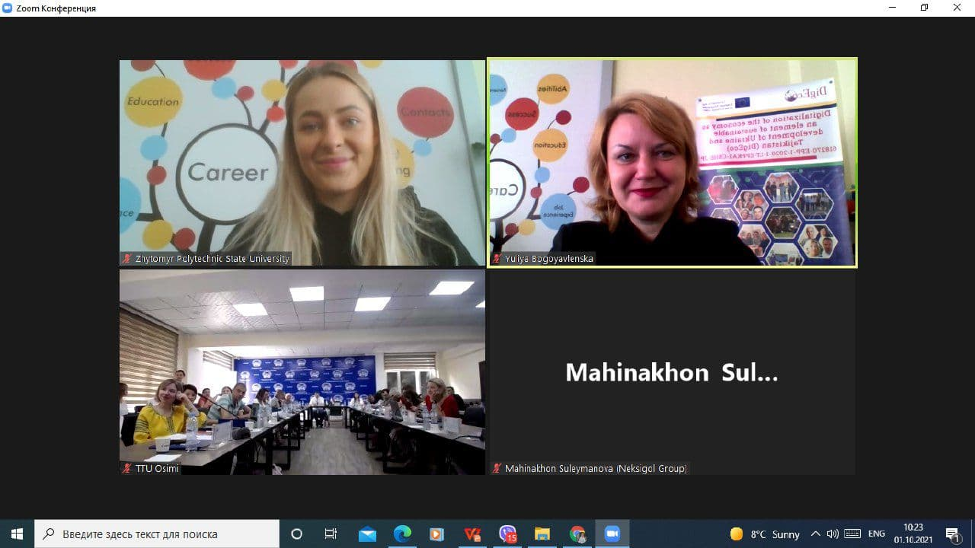
WORK PLAN: WP2
ZPSU Scientific Dissemination Events
Participation in IPTW:
reporting and development
Spin-off effects:
- video-card to Partners from Tajikistan;
- cooperation on Scientific Journal;
- more joint projects
https://news.ztu.edu.ua/2021/10/didzhytalizatsiya-ekonomiky-yak-element-stalogo-rozvytku-ukrayiny-ta-tadzhykistanu-digeco-za-programoyu-erasmus-tyzhden-pilotnogo-navchannya/
This project has been funded with support from the European Commission. This presentation reflects the views only of the author, and the Commission cannot be held responsible for any use which may be made of the information contained there in.

Slide 29
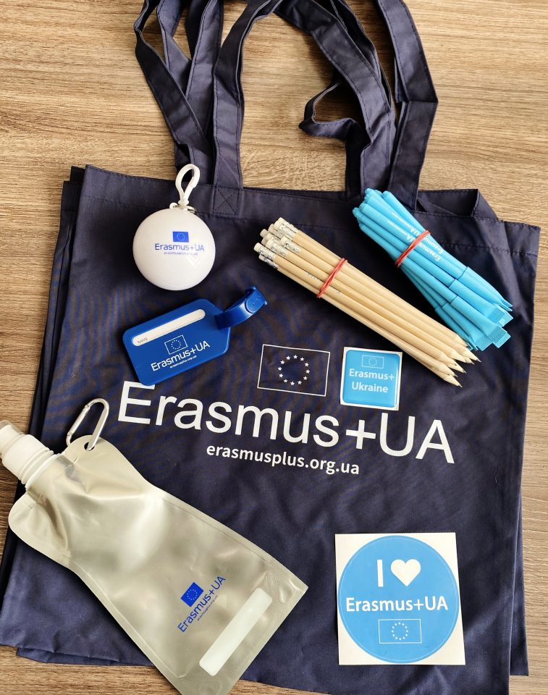
WORK PLAN: WP5
ZPSU Successful Results Events
Zhytomyr Polytechnic in the TOP-25 of the Free Economic Zone of Ukraine by the number of implemented Erasmus + mobility projects September 8, 2021
https://news.ztu.edu.ua/2021/09/zhytomyrska-politehnika-v-top-25-zvo-ukrayiny-za-kilkistyu-realizovanyh-proektiv-erazmus-mobilnist/
This project has been funded with support from the European Commission. This presentation reflects the views only of the author, and the Commission cannot be held responsible for any use which may be made of the information contained there in.

Slide 30
WORK PLAN: WP2
► Development for each Course: Syllabus, Work Plans, Lecture notes, Methodics for Practical Classes, Methodics for Self-Learning, Tests: https://learn.ztu.edu.ua/enrol/index.php?id=4179
This project has been funded with support from the European Commission. This presentation reflects the views only of the author, and the Commission cannot be held responsible for any use which may be made of the information contained there in.

Slide 31
WORK PLAN: WP2
Pilot Teaching
Within the framework of the EU Erasmus + 618270-EPP-1-2020-1-LT-EPPKA2-CBHE-JP project Digitalization of the economy as an element of sustainable development of Ukraine and Tajikistan / DigEco at the Zhytomyr Polytechnic State University the Pilot Teaching for Masters have been started September 1, 2021
https://news.ztu.edu.ua/2021/09/pilotne-navchannya-dlya-magistrantiv-v-mezhah-programy-yes-erazmus/#more-22817
This project has been funded with support from the European Commission. This presentation reflects the views only of the author, and the Commission cannot be held responsible for any use which may be made of the information contained there in.

Slide 32
WORK PLAN: WP6
ZPSU Activities
Management of the project
on different levels for P6
Deadlines: 15.12.2020 –
during DigEco running
Implementer: ZPSU
International /
Regional / Local / Virtual
project meeting
Deadlines: 15.12.2020 –
during DigEco running
Implementers: All Ps
This project has been funded with support from the European Commission. This presentation reflects the views only of the author, and the Commission cannot be held responsible for any use which may be made of the information contained there in.

Slide 33
WORK PLAN: WP6
THANK YOU FOR YOUR ATTENTION!
Yuliya BOGOYAVLENSKA PhD in Economics, Associate Professor of the Department of Digital Economics and International Economic Relations
Zhytomyr Polytechnic State University, Ukraine
Maryna PROKOPCHUK
Leading Specialist of the Center for Professional Career Development
Zhytomyr Polytechnic State University, Ukraine
Tel.: +38 (0412) 24-14-22
E-mail: yubogoyavlenska@gmail.com / zpsu.digeco@ztu.edu.ua
This project has been funded with support from the European Commission. This presentation reflects the views only of the author, and the Commission cannot be held responsible for any use which may be made of the information contained there in.

