Slide 1




P6 Zhytomyr Polytechnic State University
Erasmus+ KA2 CBHE «Digitalization of economic as an element of sustainable development of Ukraine and Tajikistan / DigEco 618270-EPP-1-2020-1-LT-EPPKA2-CBHE-JP»
Project acronym: DigEco, Priority: Social and behavioural science (Economics)
Project duration: Nov.15, 2020 - Nov.14, 2023
EU funding instrument: European Neighbourhood Instrument (Erasmus+: КА2 CBHE)
Erasmus+ (CBHE) grant amount: 995 404,00 euro
Target groups: students, teachers, people with disabilities, Government
Final meeting
Kaunas Oct 2-6, 2023

Slide 2
P6. BUDJET (on 01/10/2023)
Budget item | Cost estimate | Spent in DigEco | Balance of the estimate
STAFF COSTS | 28554,00 | 19679,70 + 8874,30 | 0 EUR (90% + 10%)
TRAVEL COSTS | 5725,00 | 6600,00 | -875 EUR (115%) | -35EUR
COSTS OF STAY | 19680,00 | 18840,00 | +840 EUR (96%)
EQUIPMENT | 34784,00 | 34 766,79 | +17,21 EUR (99,95%)
SUBCONTRACT | - | - | -
TOTAL | 88743,00 | 88760,79 | -17,79 (100,02%)

Slide 3
P6. EQUIPMENT
Tipe of equipment | Yes/no
Books and pedagogic material | No
Audio-visual equipment | Yes
Computers and software | Yes
Lab material | No
Other | No

Slide 4
P6. INVOLVEMENT OF PEOPLE WITH FEWER OPPORTUNITIES
Number of inclusive students involved so far to the DigEco Project at ZPSU – 16.
There were organized with support of National and Patriotic Education Department of Zhytomyr Regional Administration inclusion webinars:
Design Thinking (registered 17 persons, participated 26 persons) on 05/05/2023
Digital Business Models (registered 26 persons, participated 39 persons) on 16/05/2023.
Target groups: youth and women from among internally displaced persons, persons with disabilities, with post-traumatic stress syndrome, veterans / participants of the Russian-Ukrainian war, their relatives, representatives of national and cultural societies, representatives from single-parent families / mothers, guardians of a child with a disability, victims of violence, who have experienced discrimination (on any basis), segregation, victim-blaming, mobbing, bullying.

Slide 5

P6. QUALITY ASSURANCE AND CONTROL
https://dig2eco.ztu.edu.ua/qa/
DigEco Project Quality Assurance and Control are provided through activities
which are based on several official documents:
Official Order №68/od from 07/02/2021 about formation an Internal Quality Assurance Group
for implementation of the DigEco project at Zhytomyr Polytechnic State University
DigEco Quality Control Plan for Zhytomyr Polytechnic State University
General Documents of the Quality Management System at Zhytomyr Polytechnic State University:
- Quality Management System
- Internal normative base of the Quality Management System
Quality certificates
Internal quality monitoring (internal audits of the structural units activities)
Monitoring the quality of education: ( Students Surveys, Staff Surveys, Graduates Surveys)
Quality Assurance Monitoring of the Project Results: (DigEco Students Surveys,
DigEco Teachers Surveys, DigEco Stakeholders Surveys)

Slide 6
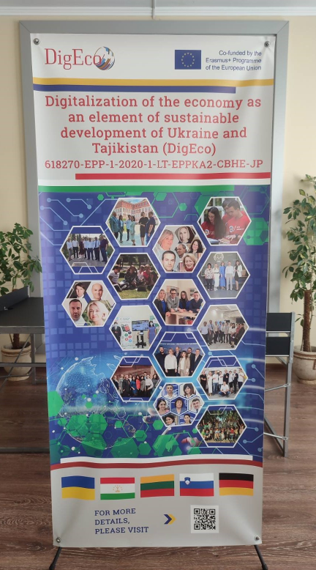
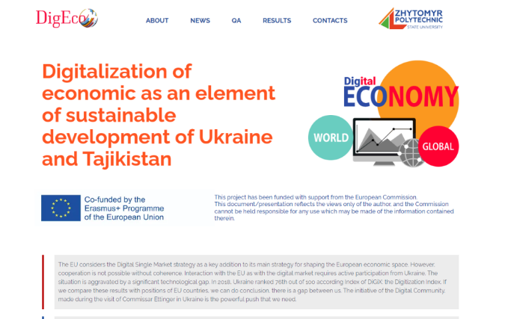
P6. VISIBILITY
According to the General visual identity rules of the European Commission Grant Agreement and Partnership Agreement Recommendations and Rules during DigEco Project Implementation at ZPSU visibility aspects were strictly followed.
All communication activities related to the DigEco Project including DigEco website, conference, seminars, information material such as brochures, leaflets, teaching materials, DigEco textbook, posters, presentations in electronic form, via traditional or social media were acknowledge EU support and display DigEco Logo, the European flag emblem and funding statement below.
It was also acknowledge EU support and display the European flag emblem, funding statement and DigEco Logo in all dissemination activities and on all infrastructure (VIDEL DigEco Lab), equipment.
All communication and dissemination materials contain Disclaimer in English:
Funded by the European Union. Views and opinions expressed are however those of the author(s) only and do not necessarily reflect those of the European Union or the European Education and Culture Executive Agency (EACEA). Neither the European Union nor EACEA can be held responsible for them.

Slide 7
P6. HIGHER EDUCATION: PROMOTING INTERNATIONALISATION, RECOGNITION AND MOBILITY, SUPPORTING CHANGES IN LINE WITH BOLOGNA PRINCIPLES AND TOOLS.
DigEco “Master” educational-professional program at ZPSU lasts 1,5 year for a total of 90 ECTS. According to the Law of Ukraine “On Education” and the Order of Ministry of Education and Science of Ukraine No. 1/9-126 during curricula developing the following rules were taken into consideration:
1/3 hours – class work, 2/3 hours - independent study;
Max 75% - compulsory discipline, Min 25% - free student choice;
The curricula consist of two parts - Obligatory and Selective part.

Slide 8
P6. MOBILITY FOR TEACHING, TRAINING AND/OR PROJECT RESEARCH ACTIVITIES
During DigEco Project Lifetime there were realized 21 Training Mobility Activities for Teachers and Staff from ZPSU:
STAFF
University Administration:
- Viktor Ievdokymov – Rector
Oksana Oliinyk – 1st Vice-rector
Halyna Tarasiuk – Dean of the Faculty of Business and Service Sector
Vasyl Mamrai – Head of International Relations Department
Artur Makhno – Deputy head of International Relations Department
TEACHERS
Faculty of Business and Service Sector (Department of Finance and Digital Economy):
Prof. Nataliia Vygovska, Assoc. Prof. Yuliya Bogoyavlenska, Assoc. Prof. Svitlana Obikhod, Assoc. Prof. Nataliia Ovander.
Faculty of Business and Service Sector (Department of Management, Business and Marketing Technologies):
Prof. Tetiana Ostapchuk, Assoc. Prof. Tetiana Zavalii.
Faculty of Business and Service Sector (Department of Information Systems in Management and Accounting):
Assoc. Prof. Dmytro Zakharov.
Faculty of Business and Service Sector (Department of Tourism and Hotel & Restaurant Business):
Prof. Oksana Oliinyk, Prof. Halyna Tarasiuk.
During DigEco Project Lifetime there were prepared by ZPSU Students and Teachers 29 scientific theses and 11 scientific articles.

Slide 9
P6. PARTNER PROJECT MANAGEMENT
In accordance with developed and approved Consolidated Management Plan, as a Part of DigEco Project
Realization Strategy at Zhytomyr Polytechnic State University was officially formed by the First Vice-Rector Order the Project Working Group (10 Persons).
The leader of P6 Project Working Group was nominated to the Project Joint Coordination Council.
The main management Tasks of Project Working Group on Institutional level are:
Ensuring the Project Goals and Objectives are completed in time and on budget: developing and approving new Curricula, new Syllabi, Teaching Materials, Textbook, Developing and Supporting Web Platform, Organizing round tables with Stakeholders, Organizing Teachers and Staff Selection for Trainings, Negotiation with NGO, Business and State representatives etc.
Financial management: monitoring budget and preparing financial reports for Coordinator, organizing
Equipment purchase procedures, Travel and Costs of Stay Reimbursement, preparing Intermediate and Final Reports to EACEA etc.

Slide 10
P6. INVOLVEMENT OF PARTNERS AND STAKEHOLDERS
During DigEco Project Lifetime there were organized 8 round table meetings with Stakeholders:
NGO, business and regional public authorities representatives.
Several Partnership Agreements with NGO and Local Business Companies were signed:
https://dig2eco.ztu.edu.ua/results/
Agreements with stakeholders:
Public organization "Zhytomyr Regional Student Innovative Business Incubator“
Agreements with stakeholders: “PJSC Mebli”
Agreements with stakeholders: “FOP Polchanov”
Agreements with stakeholders: Zhytomyr Regional Public Organization of People with Disabilities
"Youth, Woman, Family”
Agreements with stakeholders: “Advertising Agency KRAN”

Slide 11
P6. IMPACT AND SUSTAINABILITY: AWARENESS RAISING, DISSEMINATION,
SUSTAINABILITY AND EXPLOITATION OF THE PROJECT RESULTS
Main DigEco Dissemination & Exploitation Activities that were realized at ZPSU:
https://dig2eco.ztu.edu.ua/results/
Open lectures: "Digital Business Models“, "Design thinking“, "Digital services of Ukraine. “Diya“;
Students’ Master Diploma Theses Defense;
Scientific Theses and Scientific Articles Publications;
DigEco Project Web-site, DigEco Facebook page, YouTube Promo Videos, etc.
Advertisement Campaign for potential University entrances;
Conferences;
Meetings and Roundtables with DigEco Stakeholders and Public Authorities.

Slide 12
P6. CURRICULUM DEVELOPMENT
action
Courses (updated /developed/accredited) in line with Bologna principles. | All 13
Number of new/updated courses DEVELOPED | All 13
Number of new/updated courses | All 13
RECOGNISED/ACCREDITED | 13/7
Number of new/updated courses IMPLEMENTED/DELIVERED | All 13

Slide 13
Volume (in ECTS) of new/updated courses: 54 ECTS (TOTAL)
        ECTS credits contribution of DigEco disciplines at ZPSU
        (OC - obligatory component; SC –selective component)
Code | Components of the educational program (training courses, course papers, practical trainings, qualification work) | ECTS credits | Form of final control
OC | Agile project management new | 4 | Test
OC | Big data analytics and business intelligence new | 5 | Exam
SC | Big Data Analytics in Finance new | 5 | Exam
OC | Big Data Management new | 5 | Exam
OC | Blockchain, Innovation management and Disruptive technology new | 3 | Test
OC | Data Analytics for Marketing new | 5 | Exam
OC | Data Entrepreneurship in Action new | 4 | Exam
OC | Design thinking new | 4 | Test
OC | Digital Business Models new | 4 | Exam
OC | Digital Literacy new | 4 | Test
SC | Digital Marketing in Action new | 3 | Test
OC | Digital Performance in Business and Economics new | 4 | Exam
SC | Fintech in banking, insurance and asset management new | 4 | Exam
Total amount of ECTS credits: |  | 54

Slide 14
P6. THE NEW STUDY PROGRAMME INCLUDES: YES OR NO
Placements/internships for students ? YES
Career orientation service? YES
Career development measures? YES

Slide 15
P6. TYPE OF SKILLS/COMPETENCE DEVELOPED: YES OR NO
Transversal / behavioural skills ? YES
Technical /academic /scientific / research skills? YES
Linguistic competences? YES

Slide 16
P6. Training/Mobility Activities
Number of "HEI’ students" trained | 360
Number of "HEI’ academic staff" trained | 49
Number of "HEI’ administrative staff" trained | 15
Number "non-HEI individuals" trained (priv. sector, NGOs, civil servants, etc.) | Only for Parostok

Slide 17
P6. IMPACT AND SUSTAINABILITY
Impact at individual level
Extent given to vulnerable groups | Impact at individual level
Number of direct beneficiaries academic staff from HEI | 49
Number of direct beneficiaries administrative staff from HEI | 15
Number of direct beneficiaries: HEI students | 360
Number of direct beneficiaries: non HE individuals | 10

Slide 18
P6. IMPACT AND SUSTAINABILITY:
Impact at institutional level
Extent of impact at institutional level: for instance new courses / strategies (policies, regulations) / services (units, centres | Impact at institutional level
Potential of planned project measures to contribute to new national cooperation activities in the Partner countries HEIs as a result of the project (Memorandum of Understanding /research projects / joint publications participation in networks or associations etc.) | 5 Partnership Agreements with Stakeholders, 3 MoU, 15 scientific theses and 5 scientific articles, 1 Association Participation.
Potential of project to contribute to new international cooperation activities in the Partner countries HEIs as a result of the project (international agreements / Memorandum of Understanding / research projects / joint publications / participation in networks or associations, etc.) | 8 Partnership Agreements with Stakeholders, 5 MoU, 29 scientific theses and 11 scientific articles. Erasmus+ KA171 Project (2022-2025) with University of Maribor.

Slide 19
P6. MEETINGS, TRAINING AND MOBILITIES
Ref | Activity | Type of participants | Number (male/female) | Country of origin | Country of destination | Duration (in days) | % compared to objectives
1 | Digital Economics Week at Mykolas Romeris University, August 21-25, 2021 | online | 5/5 | Ukraine | Lithuania | 5 | 100%
2 | International Pilot Teaching week in Tajikistan September 29, 2021- October 06, 2021 | online | 5/5 | Ukraine | Tadjikistan | 7 | 100%
3 | International week in Hamburg (May,2022) | offline | 2/4 | Ukraine | Germany | 5 | 100%
4 | International DigEco Training week in Vilnius (June, 2022) | offline | 1/4 | Ukraine | Lithuania | 6 | 100%
5 | International DigEco Week at the University of Maribor (Slovenia) (5-7/10/2022) | offline | 2/3 | Ukraine | Slovenia | 7 | 100%
6 | International DigEco Week in Hamburg for Advance trainings on Big Data in Economics 27/02/2023-03/03/2023 | offline | 1/3 | Ukraine | Germany | 7 | 100%
7 | International Staff week in Maribor (June 5-9, 2023) | offline | 0/1 | Ukraine | Germany | 7 | 50%
8 | Intarnational Training week in Tajikistan (Sep 13-20,2023) | - | - | - | Tajikistan | - | -
9 | Final meeting in Kаunas ( Oct 2-6,2023) | offline | 1/2 | Ukraine | Lithuania | 7 | 100%

